Slide 1
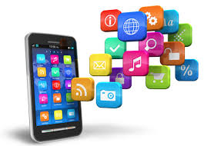
What is a mobile application? A mobile application (also called a mobile app) is a type of application designed to run on a mobile device, which can be a smartphone or tablet computer. Even if apps are usually small software units with limited function, they still manage to provide users with quality services and experiences.

Slide 2
Three Types of Apps: Native, Hybrid, and Web
1. Native mobile apps:
Native mobile apps are designed to be “native” to one platform, whether it’s Apple iOS, Google’s Android, or Windows Phone. The native platform can be advantageous because it tends to optimize the user experience. Because it was developed specifically for the platform, it can operate more quickly and intuitively.
Developed using: Objective-C, Swift, iOS SDK, Java, .NET,(C#)
Distributed in: Apple app store, Google Play store, Windows App store, Amazon App Store
Dev effort: More
Advantages: Games or consumer-focused apps where performance, graphics and overall user experience are more important
Performance: Good

Slide 3



GOOGLE NOW LAUNCHER
LAST PASS
BUZZ WIDGET

Slide 4
Web apps:
Mobile web apps are the web applications to render/deliver pages on web browsers running in mobile devices. Since these apps target browsers, they work on different mobile operating systems. You can view a mobile web app on Android, iOS or Windows tablets and phone devices. They also work on PC web browsers. Softwares’ used to develop these applications are generally HTML, CSS, Javascript, Jquery
Html- used for content of web pages
Css- used for layout of web pages
Javascript- used for behavior/functionality of the web pages
Distributed in: Web
Performance: Good in PC’s and Average in mobile browser
Apps that do not have high performance requirements, and do not need push notifications or access to device hardware/functionality
Dev effort: Less
Example: Flipkart.com, Amazon.in

Slide 5
Hybrid mobile apps:
Hybrid apps are a mixture of both native and mobile web apps. This type of application has cross-platform compatibility but can still access phone’s hardware. Softwares used to develop these apps are generally HTML, CSS, Javascript, JQuery, Mobile Javascript frameworks, Cordova/PhoneGap etc
Developed using: HTML, CSS, Javascript, Cordova/PhoneGap
Distributed in: Apple appstore, Google Play store, Windows App store, Amazon App Store
Dev effort: Medium
Performance: Average
Apps that do not have high performance requirements, but need full device access
Example: Uber, Instagram

Slide 6
Mobile Testing:
There are broadly 2 kinds of testing that take place on mobile devices:
#1. Mobile Hardware testing:
The device including the internal processors, internal hardware, screen sizes, resolution, space or memory, camera, radio, Bluetooth, WIFI etc. This is sometimes referred to as, simple “Mobile Testing”.
#2. Mobile Software or Application testing:
The applications that work on mobile devices and their functionality are tested. It is called the “Mobile Application Testing”.

Slide 7
Mobile Application Testing:
Types are:
Installation Testing
Uninstallation Testing
Update Testing
Stand By Testing
Interruption Testing
Orientation Testing
Network Testing
GPS/Location based testing
UI Testing
Battery consumption Testing
Compatibility testing
Gesture Testing

Slide 8
Other type of testing which can be done on mobile apps:
Recovery testing
Localization/internationalization
Functional testing
Security testing
Performance testing

Slide 9
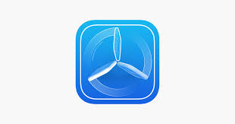

Installation testing:
Process to check whether app is installed properly without errors.
Procedure:
Step 1:
Install the app from Google play store/Apple app store/amazon app store or Google drive or Beta Distribution Channels like Test Fairy , Test Flight (all hardware details will be recorded and screenshots and screen recordings of the app under test and crash details , battery consumption, logs, network performance once the app is installed.

Slide 10
Scenario Example on installation Testing when installed from app stores:
Application should be searchable
Verify the install button is present or not
Verify that on clicking installation button , installation starts
When the data is turned off in between installation should pause
When the data is reconnected the installation is resumed
When clicked on cancel button installation should stop
When installation is complete , open and uninstall button should be displayed
Verify app is getting launched by clicking on open button.
Verify after successful installation the app should be present in app drawer
Verify the icon of app
Verify installation when internal memory is full, external memory is free
Verify installation when external memory is full, internal memory is free
Verify installation when both memory is full

Slide 11
Try installation in different network speed
Try installation when receiving a audio/video call, text, notification, ads, alarms, reminders.
Try installation when data is very less

Slide 12
Update Testing: Process to check app updation is successful
scenario examples:
Check notification is received when update is available.
Update button should be displayed in the app store
After updating old data should not be erased
Try updating in different conditions similar to installation scenarios.

Slide 13
Uninstallation Testing: Process to check un installation is successfull.
Scenario Example:
Check after un installation app should be removed from app drawer
When installed again user should not be logged in

Slide 14
Stand By Testing: Process to verify crashes and UI images within the app when app is in standby phone is in sleep mode.
Scenario examples:
Check the app behavior and putting the device in standby mode for few secs/ minutes/ hours and waking it up

Slide 15
Orientation Testing: Here we verify the UI by rotating device in landscape mode from portrait mode and vice versa.
Interruption Testing: Here we verify the app stability by interrupting it with the call, messages, charging, flight mode, notifications, blue tooth, warnings, ads, different networks etc.
Network Testing: Test the app in different network speeds like 2g, 3g, 4g , wifi, offline etc

Slide 16
Compatibility Testing: Testing the app in different form factors like:
OS: Android/ios/windows
RAM
BATTERY CAPACITY
SCREEN RESOLUTION
SCREEN SIZES
ETC.
Install app DEVCHECK for getting the device specifications.

Slide 17
How to do compatibility testing without real device??
Solution is -
1. SIMULATOR: Software that mimics Internal behavior of the device. It does not mimic hardware. Eg:Apple’s iOS Simulator
2. EMULATOR: Software that mimics Mobile device software
Mobile device hardware, Mobile operating system.
Eg: Google’s Android SDK
A simulator/emulator cannot mimic the following features −
Mobile device battery
Mobile device’s camera
Difficult to mimic interruptions like incoming calls and SMS.
Not so much realistic simulation for mobile device memory usage.

Slide 18
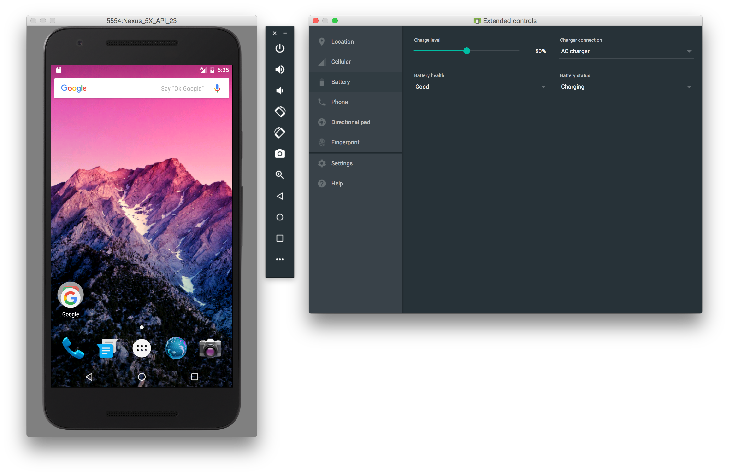
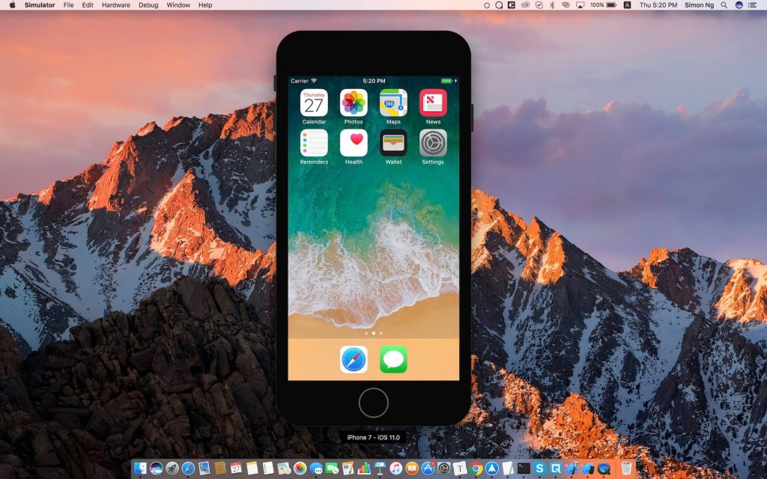

Slide 19
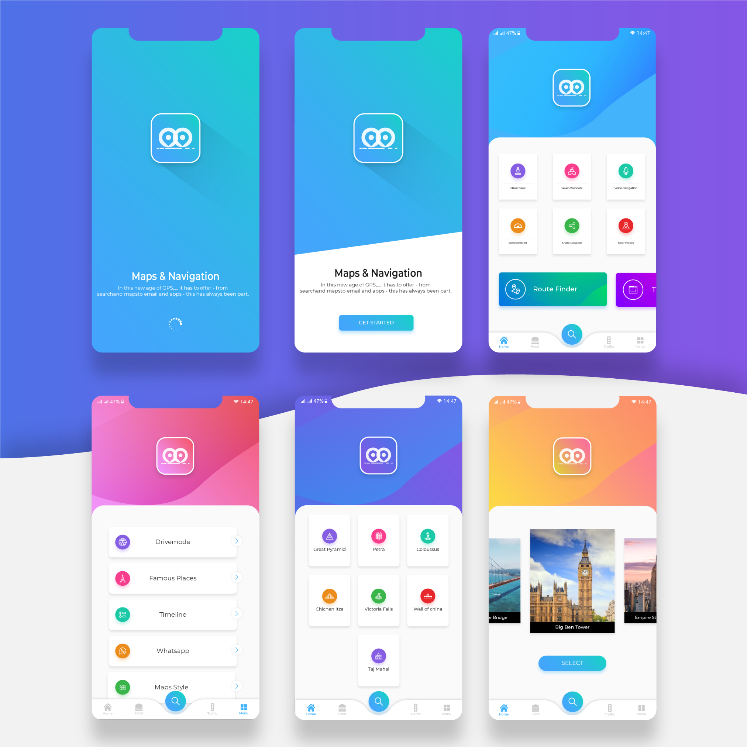
UI TESTING: Here we test all the user interface of the app.
Color
Font sizes
Spacing
Alignment of buttons, fields etc

Slide 20
Gesture Testing:
Test the app through different possible gestures
Tap/double tap
Pinch in, pinch out
Swipe
Slide
Drag
Shake

Slide 21
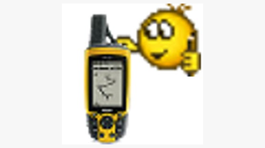
GPS TESTING(optional)
Test the app by changing the device location
Steps:
Install app FAKE GPS from playstore
Enable DEVELOPER MODE in your phone
Go to settings> about phone>click 7 times on build no.> open fake gps app.> come back to phone settings> go to developer options>open mock location>select fake gps app>set the location to desired location> click on run>open ola/uber/watsapp live location> the new selected location is shown.
To stop simply click on stop icon on fake gps app
Off the developer options .

Slide 22
Android 9 (API level 28) and higher: Settings > About Phone > Build Number
Android 8.0.0 (API level 26) and Android 8.1.0 (API level 26): Settings > System > About Phone > Build Number
Android 7.1 (API level 25) and lower: Settings > About Phone > Build Number
-------------------------------------------------------------------
Android 9 (API level 28) and higher: Settings > System > Advanced > Developer Options
Android 8.0.0 (API level 26) and Android 8.1.0 (API level 26): Settings > System > Developer Options
Android 7.1 (API level 25) and lower: Settings > Developer Options

Slide 23
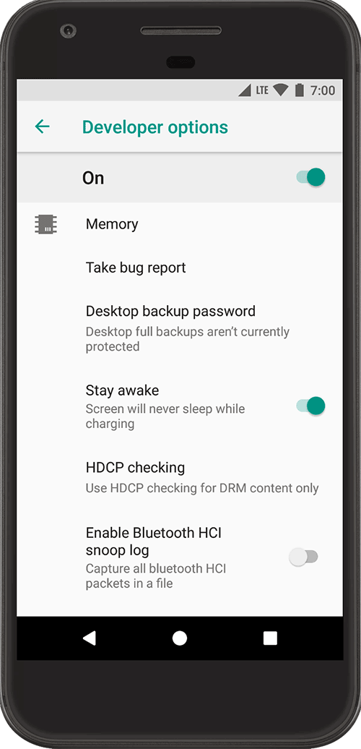
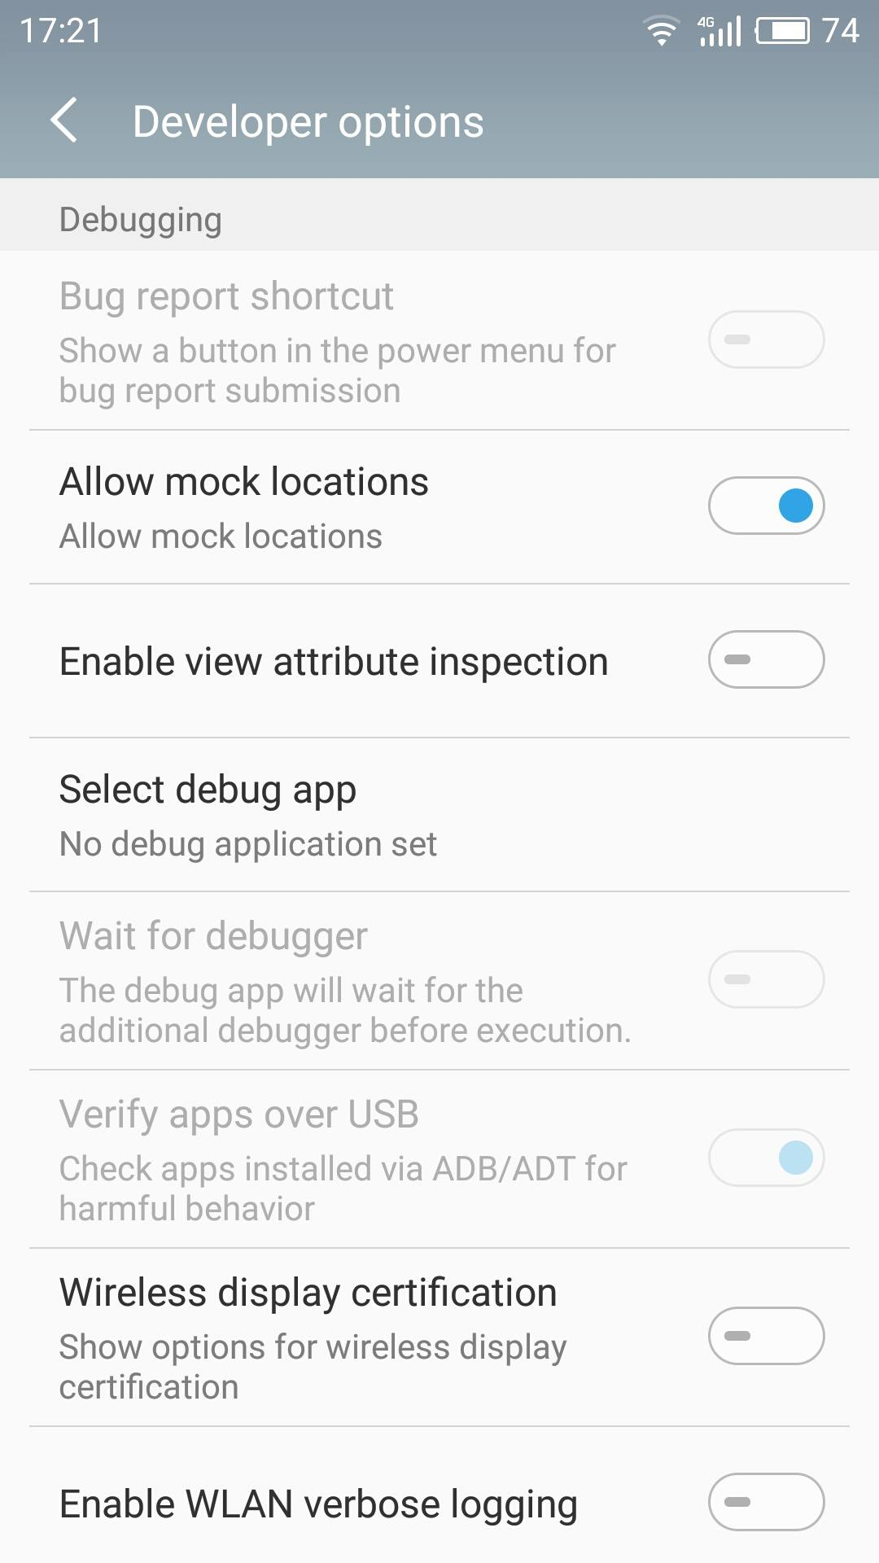

Slide 24

When to choose automation testing and when manual testing?
Manual Testing
If the application has new functionality
If the application requires testing once or twice
Automation Testing
If the regression tests are repeated
Testing app for complex scenarios
APPIUM: Appium is an open-source automation mobile testing tool, which is used to test the application
Other tools: robotium, selendroid, eggplant, kobiton, monkey talk, testdroid

Slide 25
Mention what are the common bugs found while mobile testing?
Critical: Your phone system crash when testing particular feature in your device
Block: Unable to do anything though phone is on unless you reboot your device
Major: Unable to perform a function of a particular feature
Minor: Under minor bugs usually GUI bugs fall.

